Slide 1



M1: START WITH THE MESSAGE
Jumpstart Your Practice Online Program
Michael Warren DVM GCP
Notes:
Welcome to the Start with the Message module of the Online Client Engagement Program brought to you by the Partners for Healthy Pets
Now this may seem like an unlikely topic to have introduce an online strategies series, however the importance of powerful and effective messaging cannot be understated. Proper communication underpins everything we do as we strive towards effective client engagement, and doing so via online media still demands the same attention and thought.

Slide 2
THE SMART START
$
FREE
# Potential X Conversion Rate % = # New Clients
500
10% =
50
500
30% =
150
Notes:
Let’s start with a useful equation to keep in mind through this whole series is Visibility x Conversion Rate = Engage More Clients
----
First we have visibility, which is everything that brings potential clients to your practice. .
It is typically what you pay for and could include your – website marketing, yellow pages, local newspaper ads, signage, word of mouth
Basically, visibility is your marketing efforts.
Next we have the Conversion rate - the degree to which your potential clients become your actual clients.
The big driver of conversion rate is how compelling your message is, or how well you’re able to convince those potential clients looking for a vet to join your practice and become your active clients.
So if we want to increase our new clients, and prepare these new clients for a good experience with us, we have to increase either our visibility or our conversion rate. If we increase our visibility, it’s going to cost money. The only way to do this is to invest more in advertising and marketing, to spend more dollars to get in front of more people
On the other hand, improving our conversion rate can be free, and again is largely dependant on how well we message about our practice. We can do this ourselves with no help from outside parties.
What’s more, if we’re able to increase our conversion rate, then any money we put into the visibility (marketing) component is likely to result in even more new clients (i.e. more people that are attracted to our practice are going to encounter our powerful message and choose us as their pet health care provider when they otherwise my not have). Conversely, if we have a terrible conversion rate/ ineffective message, then no matter how much money we spend on visibility we’re never going to get a positive ROI.
Here’s an example:
Let’s say that every month, 500 new potential clients are coming into contact with your practice message. If you have a 10% conversion rate, you are actually seeing 50 of those actually walk through your door. So, we can either spend double or even triple what you’re spending to increase that visibility from 500 to 1,000 or 1,500. Or, we can spend no money to increase your visibility, but focus on conversion rate instead. We’ll have the same 500 potential clients, but we’ll increase the conversion rate from 10% to 30%. Instead of 50 new clients, we’ll end up with 150 new clients each month, just by changing the perception of our practice – and with no further outlaying of money.
So how do we do this?
The basics are rooted in the principles of Perception and other Psychological motivators.

Slide 3
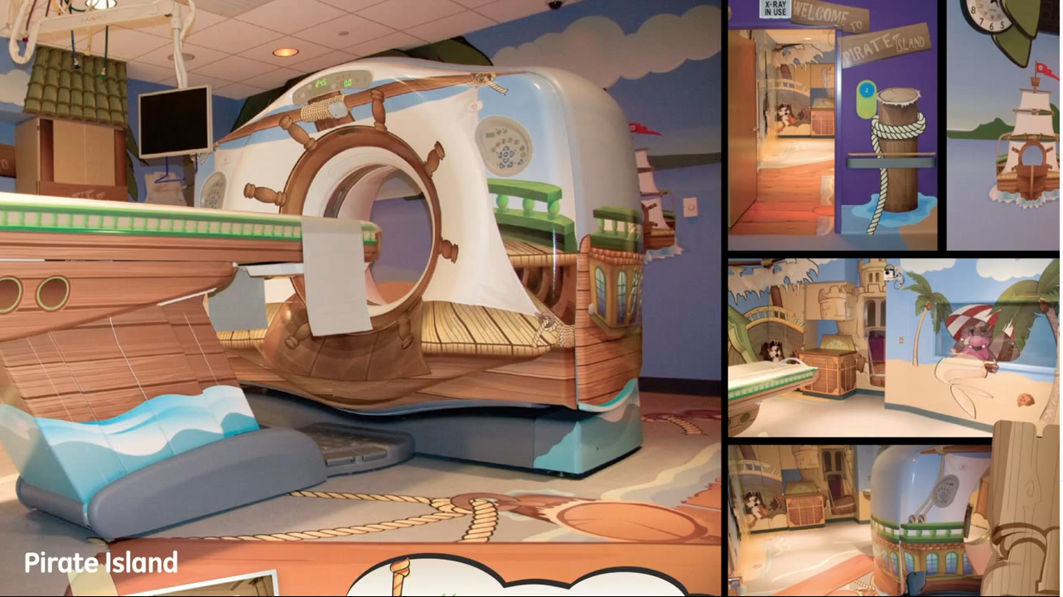
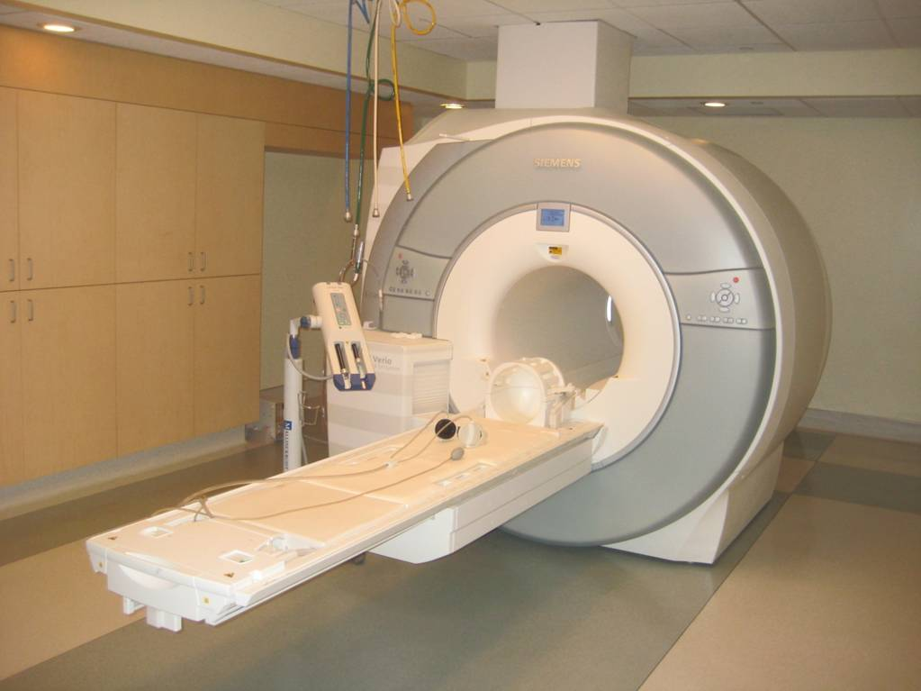
CLIENT PERCEPTION IS CLIENT REALITY
Notes:
Let’s start with Perception, as, quite frankly, Perception is reality
For our clients, who often cannot easily assess our level of medicine per se, (often one practitioner seems as good is the next), all they have to go on when choosing their practitioner is how they (often outwardly) perceive us
The story of Doug Detz
- was in the hospital saw young family and saw a little girl who was crying and was terrified
- moment of hurt to see the fear machine caused in kids
- He learned that over 80% of kids had to be sedated to deal with the MRI machine
- before he was proud but this was a blow
- turned it into an adventure
- turned it into an experience, must be very still because we don't want the pirates to find you
- results were dramatic, from 80% requiring sedation to 10% requiring sedation
was with one of the mothers waiting to come out of scan - she ran up to her mother and said "Mommy, can we come back tomorrow“
Thus, Perception becomes the reality of the experience
We need to make the experience something our clients can understand, can identify with, and are comfortable being a part of
Again, although they cannot easily asses our medicine, they can, and will, JUDGE us on what they outwardly perceive
Like our messaging, our websites, our reception area

Slide 4

DUPLICATE SUCCESS
Notes:
So, if we are able to make a good 1st impression, and stack the odds of a potential client viewing coming to as a likely resulting in a good experience, then they WILL come to us – which is what we want in order to ensure increased pet health.
Again, the way to start this process is by crafting a compelling message, and one that will be used repeatedly on all of your marketing materials. If we get it right, and it’s great message, then we’ll be able to duplicate the success that comes from it. However, if we just engage in this halfheartedly, without thinking about what we’re conveying, then not only will we be missing a chance to attract clients legitimately and reliably, but we’d also just be duplicating failure.
It’s important that we get it right because this message is going to be the foundation of what we do together over the next several sessions.

Slide 5



WRITE DOWN YOUR PRACTICES MESSAGE…
Notes:
So, I would like you to take the next 30 seconds and write down your practice’s message. Make sure you have a pen and paper handy.
To help, I would like to set the scene.
I would like you to imagine that you have just stepped on to an elevator in an office building, but just as the door closes someone put their hand in, stopping the doors and joins you.
She’s middle aged and jokes that she is a paralegal and is late for a meeting. She asks what you do and you say you are a veterinarian.
She says “Oh that’s perfect as I just moved here and have a boston terrier who has really bad breath and probably is due for a check up. I havent found a local vet yet – tell me about your practice.”
Now in the next 30 seconds right down your practice’s fundamental message – the 30 second elevator pitch!
5 seconds left.
Okay good. Now keep this for now as we are going to come back to your original message to see if there’s a difference from the one you end up with.

Slide 6
3
PRINCIPLES OF
CLIENT ATTRACTION
Notes:
So lets get to the meat and potatoes.
In terms of attracting clients, all too often vets think too clinically, and the reality is that in non-medical instances what is really indicated is for us to remove our veterinary hats…and just relate to our clients as people

Slide 7

THINK LIKE YOUR CLIENT
1
Notes:
All too often, we think like veterinarians when what we have to do is take off our veterinary hat. From experience, we tend to emphasize the features of our practice rather than the benefits for our clients. We tend to say what we do and we forget the compassionate elements. We have to instead think like our clients in every single thing we do, in every single piece of marketing material.
Think of your clients’ problems and frustrations, and endeavor to address these issues
If we are not:
Thinking like our clients
Feeling like our client
Desiring like our client
Then we’ll never be able to deliver the experience our client is seeking – we will miss the mark every time.
So every aspect of how we craft the message and the perception of the practice MUST be viewed through the psyche of our client.

Slide 8



START WITH WHY
2
WHY?
HOW?
WHAT?
Notes:
Start With Why – Written by Simon Sinek, this basic principle holds that when we communicate, we naturally focus on what we do and how we do it. Rarely do we say why we do it. What we have to do is, instead of saying what, how and why, in that order, we flip it on its head. We start with why – the inspiration of why we do what we do. That becomes the core of our messaging.
Tell story of ‘30,000 songs in your pocket’ versus 5 gigs of music memory that no one could understand or identify with
People don’t care about what we do – they care about why we do it!.
Our objective as veterinarians is to inspire our potential clients in the same way, compel them to choose us as their carer. Like with Apple, our clients want to know how choosing you will benefit them, speak to convenience, and really touch at the heart of what they are really after- an assurance of their pets wellbeing.
We do this by inspiring with our common ground – our love of animals. No matter who your client is, they bring their animal to you because you have a shared compassion for animals. That similarity, that inspirational element, is what we have to focus on. We have to start with why, and then go into how we’re different, and finally, what we do. People do not buy what you do, but they do buy why you do it. We’re going to start with why in our messaging, and with that we’re going to create our boilerplate, which is what we’re going to use to duplicate our inspirational messaging over and over again.

Slide 9


USE EMOTIONAL MOTIVATORS
3
The 5 C’s
Community
Consensus (Social Proof)
Compassion Connection
Care
Call to Action
Notes:
Use Emotional Motivators – What are psychological triggers, and how can and should you use them to motivate potential clients to actually come into your practice?
Community. If we can show that your practice is involved in the community, it’s going to increase trust and make it a more attractive place to visit. A great way to do this is through Facebook. If you had two options, for example, when evaluating which dentist to go to, and one dentist had only a few fans, while the other one had over a thousand fans, which one would you choose? Probably the one that has all that community support around him, because it gives the impression that he is a trusted professional. The action point for community is to set up a Facebook page and then incorporate those fans into your website.
Consensus (Social Proof). Saying how good we are ourselves only goes so far before people stop listening. What you have to do is get your clients to speak for you. For example, we can use testimonials. Every piece of marketing material should display these testimonials. Another impressive piece of social proof is to cite the number of our clients. Rather than saying, “Come to ABC Vet Clinic, we’re so great, we do xyz…”, instead say, “Come and join the 5,000 pet owners who call ABC Vet Clinic their trusted veterinarian”. That has a much greater impact. Through using a testimonial or an actual number, you can show that there are a lot of other people who have put their trust in your practice.
Compassion Connection. People bond with those that have a familiarity to them and who they can relate to, so we need to make sure that any opportunity to be like our clients is showcased. In veterinary medicine we are fortunate to share a powerful common ground with all of our clients and I call this the Compassion Connection. Through emphasizing our personal compassion for our work (treating animals) we are able to create a powerful connection with our clients – because it is that same compassionate element that is driving them to their veterinarian. The more we can reveal, the greater our attractiveness and the degree of engagement will become.
Care. Focus on the care they and their pets will benefit from, not the features they will dispassionately receive. From experience, vets tend to emphasize and list the features of our practice boast rather than the benefits our clients will actually enjoy. We tend to say what we do and we forget the elements that people actually care about, and that will lead to a connection. Given this, we have to think like our clients in every single thing we do, in every single piece of marketing material we create. For example, if you want to promote your veterinary dentistry, instead of describing what you do in the process of addressing that issue medically, think of what types of presenting issues your client is confronted with that suggests their pet may need an intervention, such as the bad breath they smell each day, and show them how bringing their pet to you will take care of this.
Call to Action. It’s been shown that a call to action, or simply saying what you want people to do, has a significant impact. What does this mean for veterinary practices? On our websites we have to use phrases like, “call us today”, “reserve your appointment”, “call us now”; anything that will motivate people to actually pick up the phone and call. I recently registered for a webinar, and at the end of the registration process, it said “mark this in your calendar now”. I would have missed that if not prompted to do so. If we don’t tell people what to do, we’re relying on them to be self-motivated enough to take that action, which they may never do.

Slide 10
3
Action steps
Notes:
Label: None
Image Theme: The words on a greyed out background – something like http://screencast.com/t/b4PEKyet or this http://screencast.com/t/b4PEKyet
Design Notes:
Content Notes:

Slide 11

SEARCH LIKE YOUR CLIENT
1
Notes:
We as veterinarians think in terms of quality and integrity while our clients think in terms of compassion and service. This means we have to deliver the compassionate element in a major way.
So the action plan here is to get a sense of what your clients are experiencing – especially their initial impressions – when they come across your clinic (online or otherwise) for the first time
I’d suggest you:
-search for ‘vet’ + ‘your locale’ (do you appear high in the search engine results? Would you expect clients to find you using this medium?)
-go to your website (what sort of mood does it convey and connection does it make? Would you be likely to want to visit this clinic based on the website?
-call you clinic – what is the ‘reception’?
-scan your waiting area – is it inviting? Is it comfortable?

Slide 12

START with ‘WHY’ BOILERPLATE
2
  WHY?
  HOW?
  WHAT?
Notes:
The term boilerplate originated in the 1890s where boilerplate was actually cast or stamped in metal ready for the printing press and distributed to newspapers around the United States. It is nowadays any text that can be reused in new contexts or applications without being changed too much from the original
Your boilerplate is your short 1-3 sentence inspirational message about your practice. Once created and perfected you will systematically use this message over and over again without having to think about it – and can start with inserting it in the ‘About Us’ page. This makes the difference between agonizing at the end of every piece of writing you compose, trying to try and come up with something catchy that turns out to always be imperfect, and a time saving phrase you have already created and that accurately reflects who you are.
Now you can just copy and paste your boilerplate and you’ll have a perfect inspirational message everytime – starting with the brief description often found on a websites homepage. ,
Forget having to cobble together a readers digest version of who you are that will sound different every time –
Now your message will be consistent and will always convey exactly what you want it to.
So let’s try it!
[walk them through answering the why-how-what questions]
What you have just created is called a boilerplate.

Slide 13


3
CREATE EMOTIONAL MOTIVATORS…
...& START WITH THE MOST POPULAR PAGE
Notes:
The next step is creating the most powerful emotional motivator available to us as veterinarians – that is compassion connection.
There is the old saying:
“Clients don’t care how much you know until they know how much you care”
It is precisely this caring and compassion of animals that is the shared connection with the client – this is the bonding factor – this is the common denominator of likeness that makes the client feel comfortable – and not feel they need to look to anyone else to trust.
However, many vet websites are great at telling a story, they lack the tendency to share the compassion that clients look for. What we have to focus on is the inspirational element, and we’re going to start with the most popular page on the veterinary website – the “about us” page. Clients come to the homepage, and then go right to the “about us” page. If they make that connection, they’ll then go to the “contact us” page and then perhaps the services page.
Many vets are surprised to find out that the services page is not anywhere near number one, in fact it’s number nine on the list of pages visited by potential clients. On average, people spend only 26 seconds on the services page, and almost double on the about us page. This is proof that potential clients aren’t coming to our sites to analyze our services, but they’re coming to make a connection. If we can inspire them in those few seconds that they’re visiting our site, it’s going to drive the growth of our practice.
How we’re going to create that compassion connection is by transforming our ‘About Us’ and bios using the 7 key client-bonding questions, and focusing on the inspirational element.

Slide 14
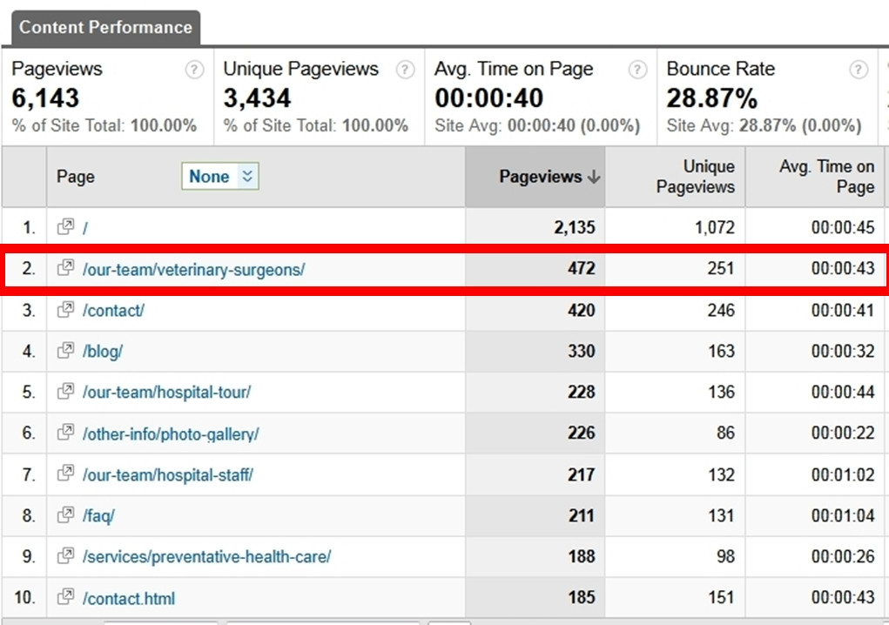
3
Notes:
Many vets are surprised to discover that the services page is not anywhere near number one, in fact it’s number nine on the list of pages visited by potential clients. On average, people spend only 26 seconds on the services page, and almost double on the about us page. This is proof that potential clients aren’t coming to our sites to analyze our services, but they’re coming to make a connection. If we can inspire them in those few seconds that they’re visiting our site, it’s going to drive the growth of our practice..

Slide 15
7 Client Bonding Questions…
1
WHAT are your personal origins?
WHAT is your position in the clinic?
2
WHY did you become a veterinary professional?
3
HOW did you become a veterinary professional?
4
5
WHAT is your role as a veterinary professional?
WHO is in your family & their interests (pets too!)
6
7
WHAT are your personal interests and achievements?
Notes:
Content Notes:
How we create that compassion connection is by transforming our bios using the 7 key client-bonding questions, and focusing on the inspirational element/ Here is a list of questions to ask yourself whenever you are composing your Biography excerpts.
What are your personal origins?
What is your position in the clinic
Why did you became a veterinarian?
How did you became a veterinarian?
What do you actually do as a veterinarian?
Who is in your family and what are their interests (pets too!)?
What are your personal interests, and achievements?
Why not DO THIS NOW!!!

Slide 16

AVOID THESE COMMON MISTAKES…
Offering a Laundry List of Features
Providing No Clear Benefit To Clients
Using a Single Large Block of Text
Being Superficially Compassionate
Notes:
We as veterinarians think in terms of quality and integrity while our clients think in terms of compassion and service. This means we have to deliver the compassionate element in a major way.
So the action plan here is to get a sense of what your clients are experiencing – especially their initial impressions – when they come across your clinic (online or otherwise) for the first time
I’d suggest you:
-search for ‘vet’ + ‘your locale’ (do you appear high in the search engine results? Would you expect clients to find you using this medium?)
-go to your website (what sort of mood does it convey and connection does it make? Would you be likely to want to visit this clinic based on the website?
-call you clinic – what is the ‘reception’?
-scan your waiting area – is it inviting? Is it comfortable?

Slide 17


Search For Your Practice
Transform Your Bios
Create Your BoilerPlate
Notes:
Search for your practice online to think like your client and see what they’re actually experiencing. As you go through this, make notes on the touch points and have your psychological triggers next to you so that you can learn how to incorporate those triggers to motivate your prospects to take action and become your client.
Take the start with why worksheet and create your boilerplate. This is going to be the inspirational message that is going to be on every piece of marketing material for your practice.
Transform your bios. Make sure to take your 7 client bonding questions and have everyone in your practice answer those questions. This will transform your bios from something that is probably lackluster and small, to something that is going to be inspirational in telling your stories.
Remember to share that inspirational moment, whatever it is, and double it to really showcase it.
Study the psychological triggers and implement them onto at least your homepage. Look at your homepage and add, for example, how many clients you have in your practice, a call to action and testimonials (if you’re in the U.S.).

